Slide 1




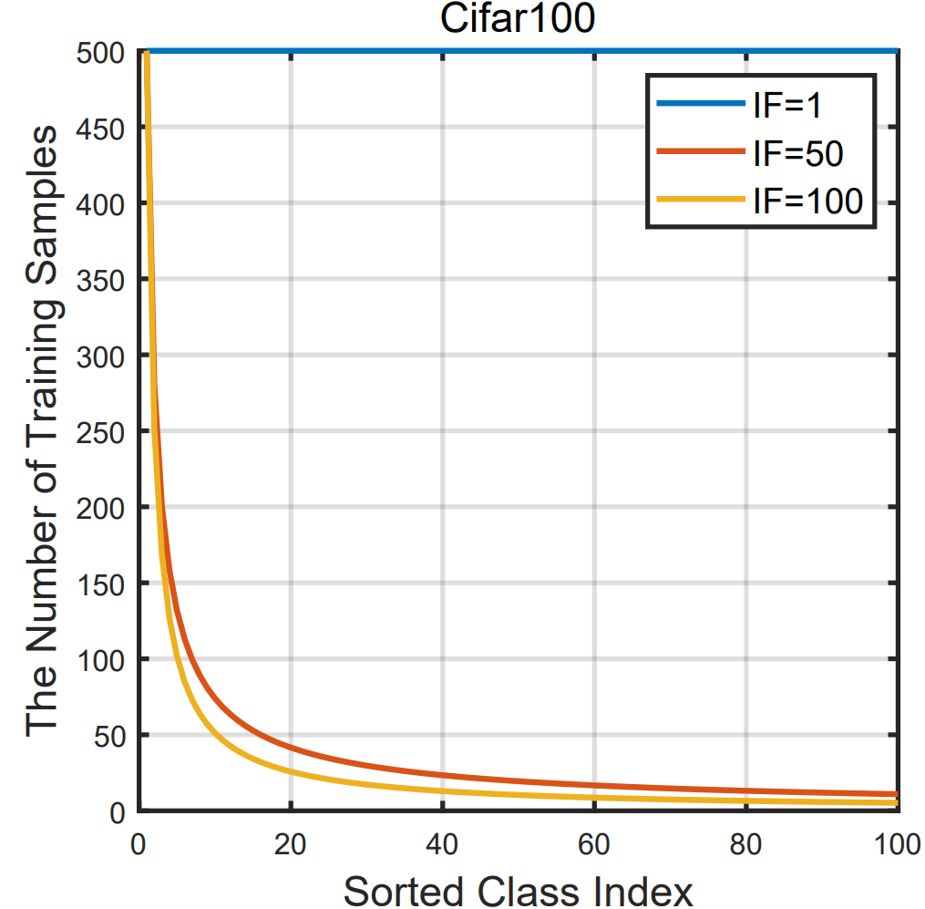

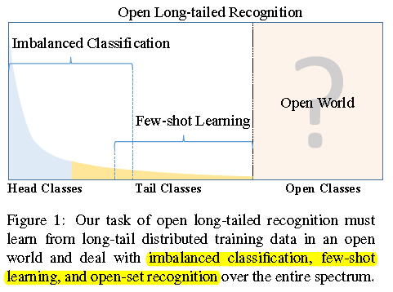
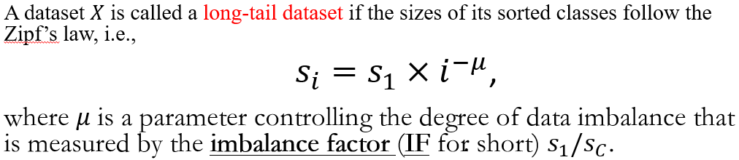
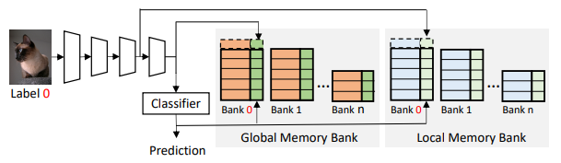
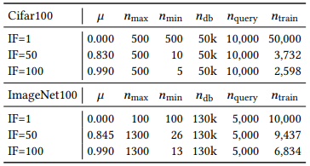
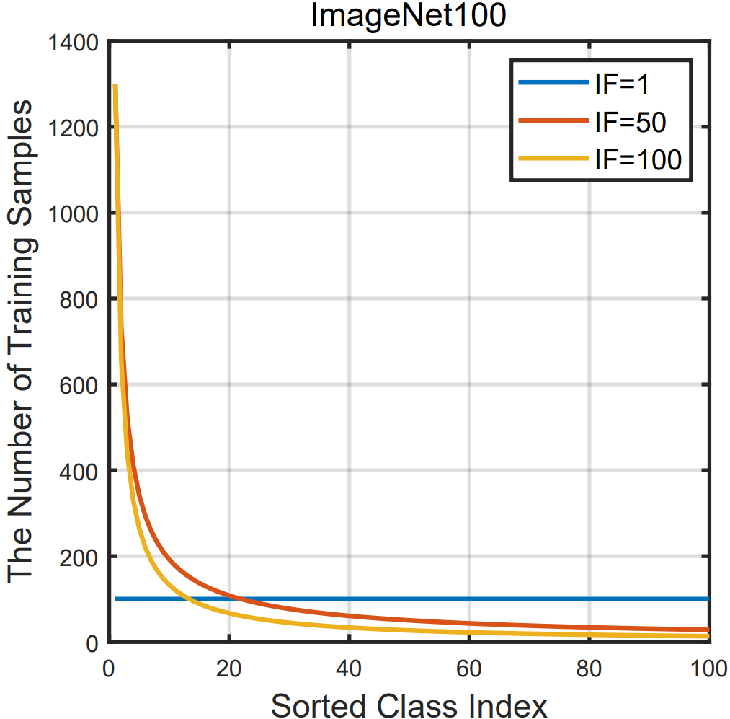
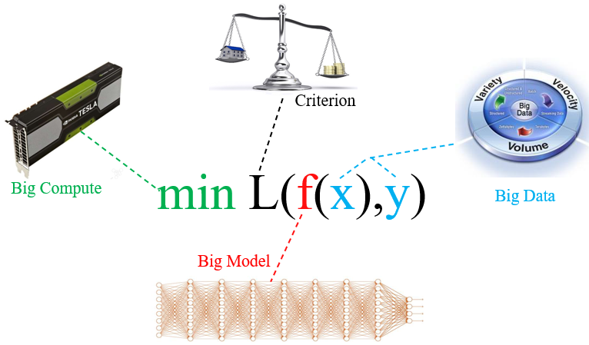

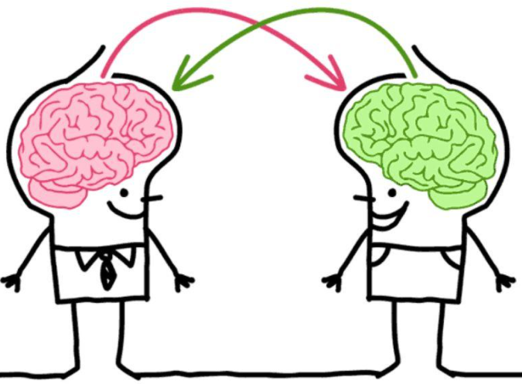
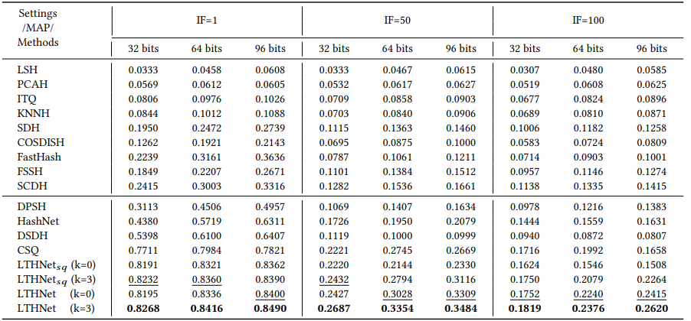
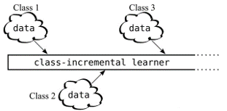
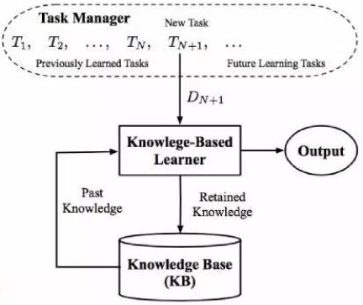
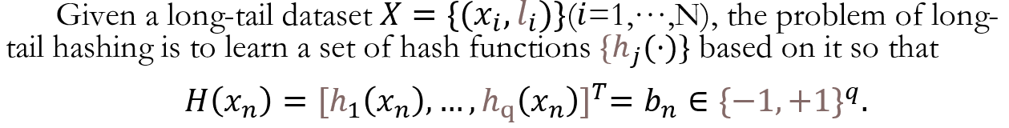
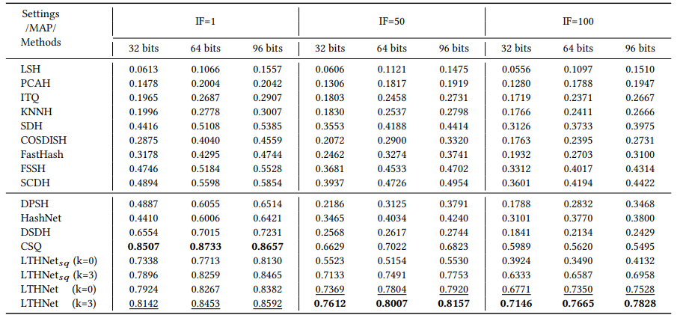


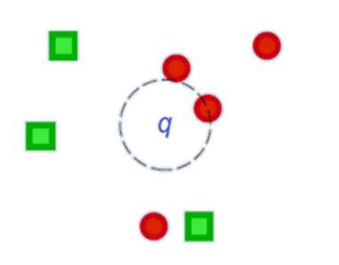
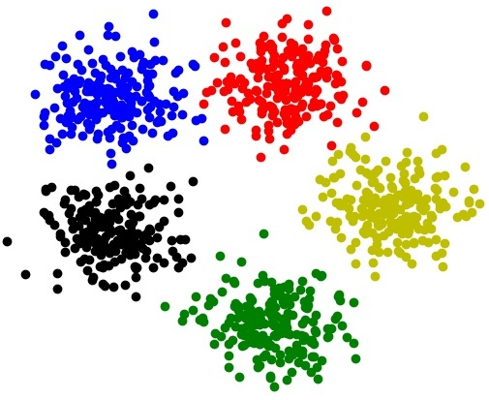
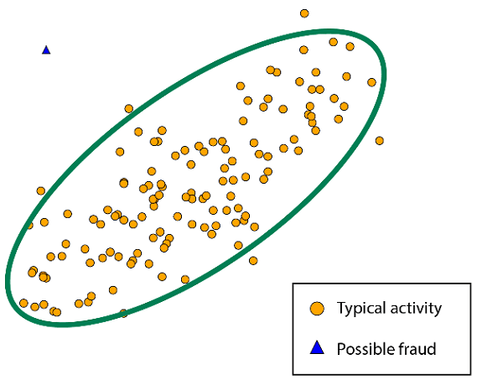
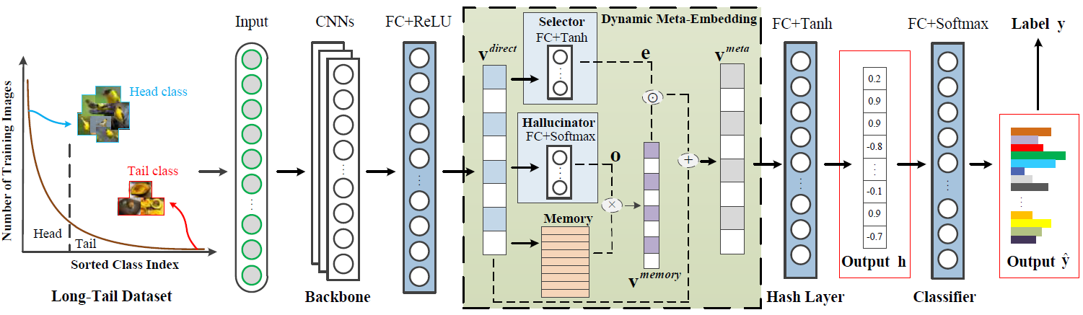
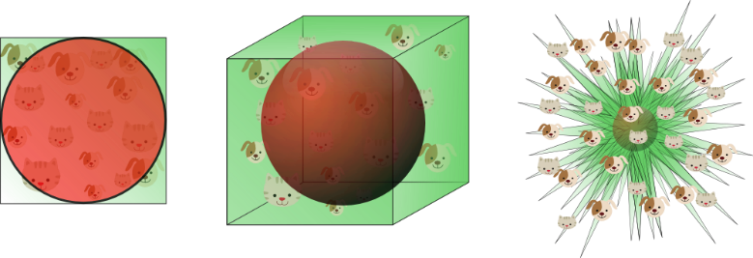


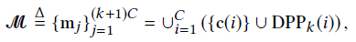
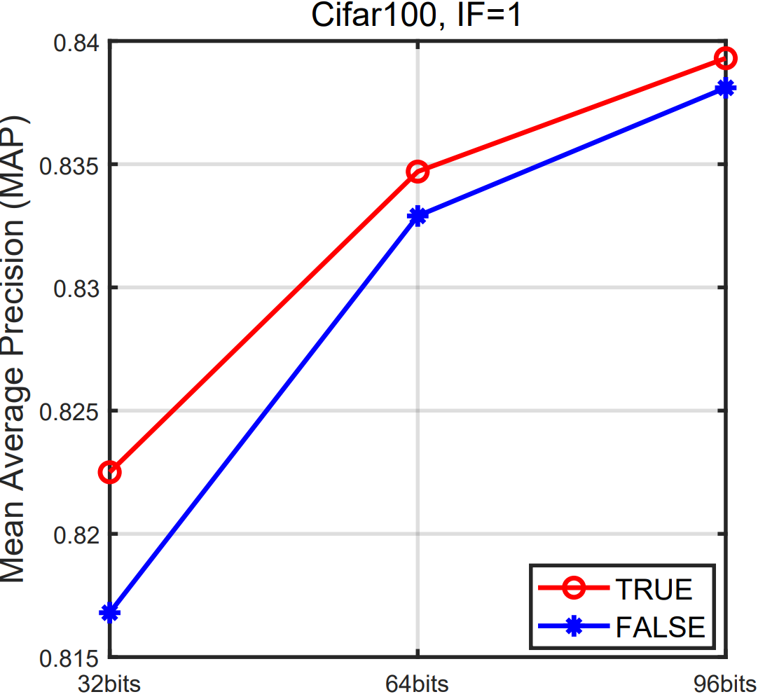
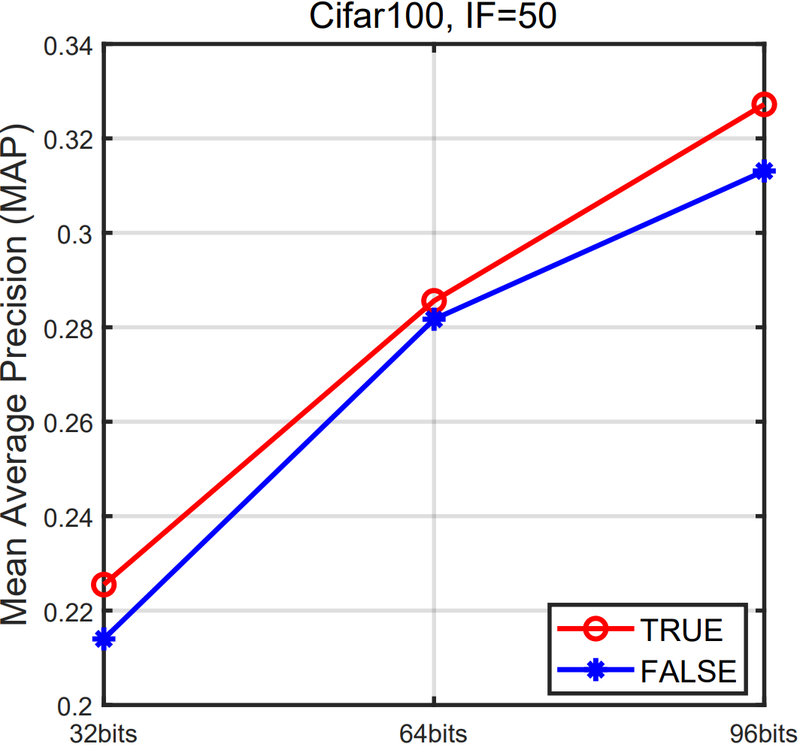
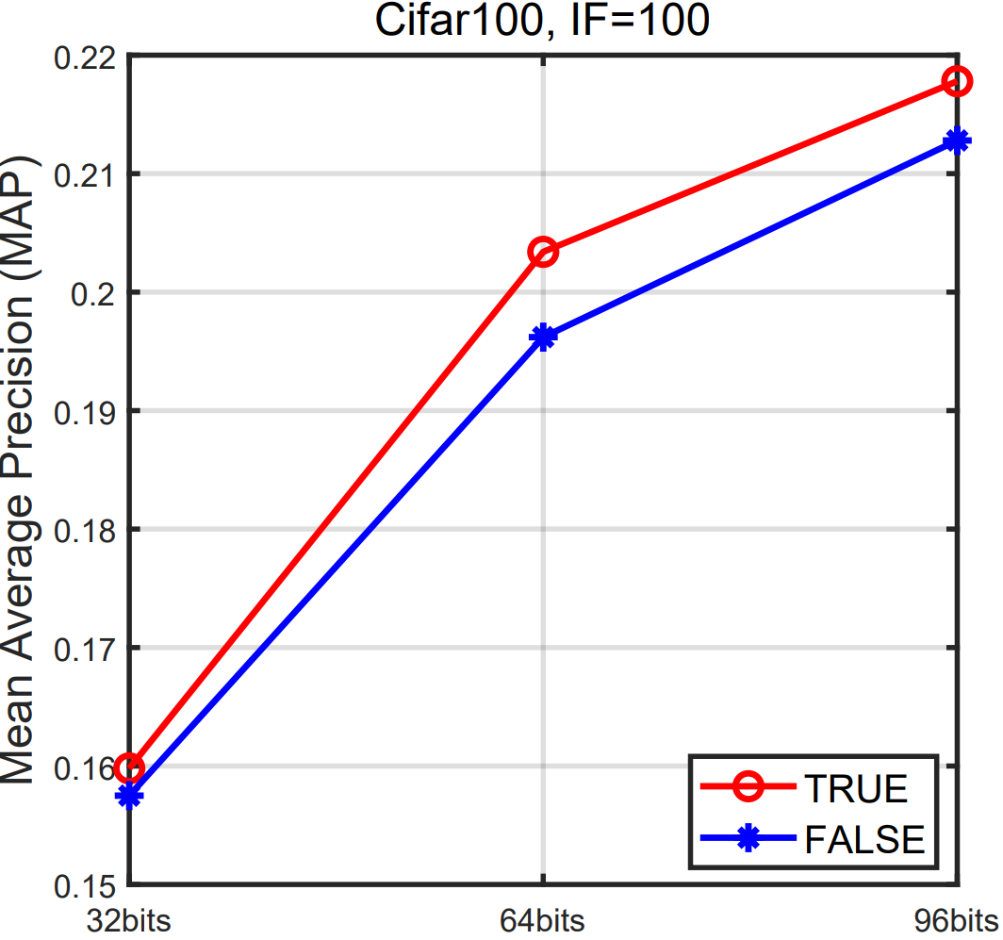
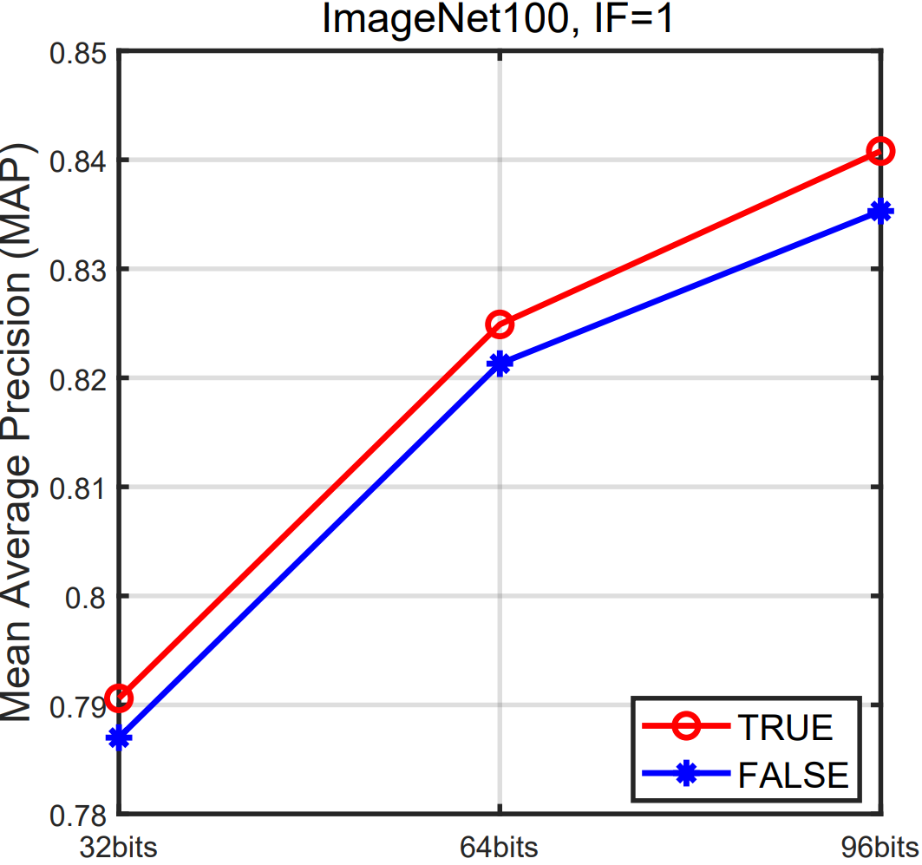
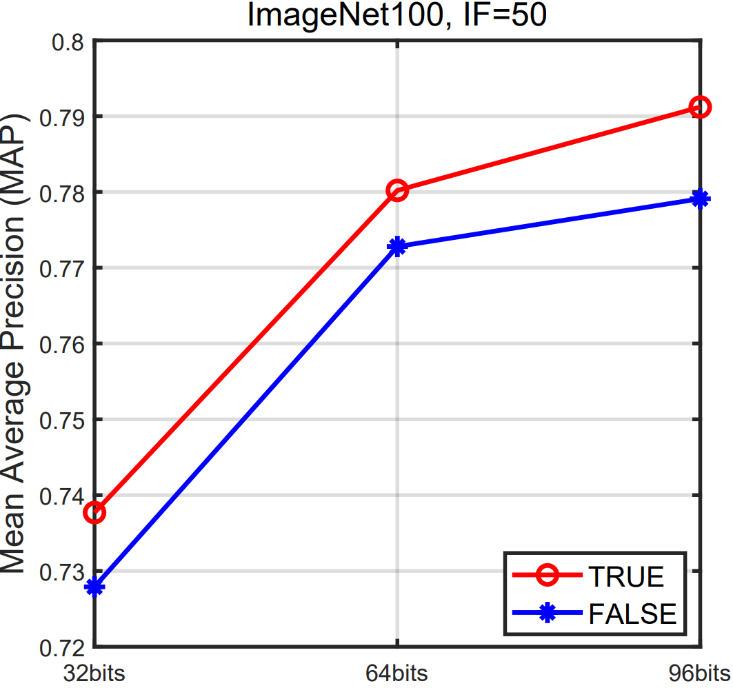
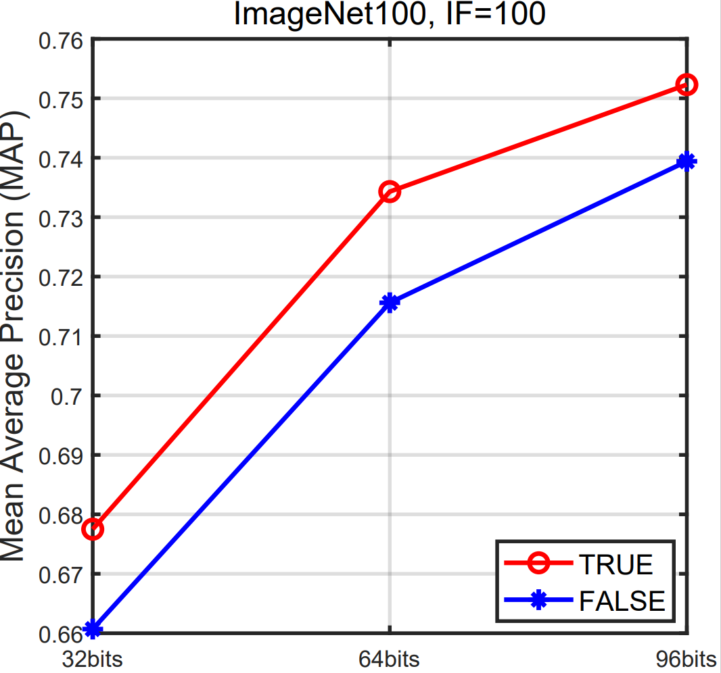
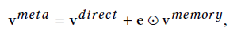
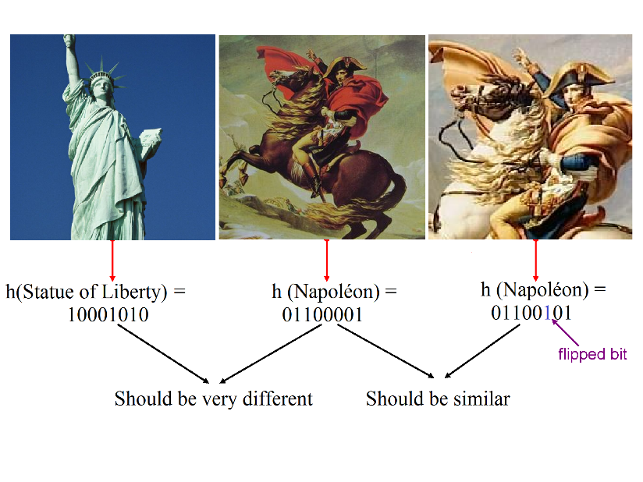
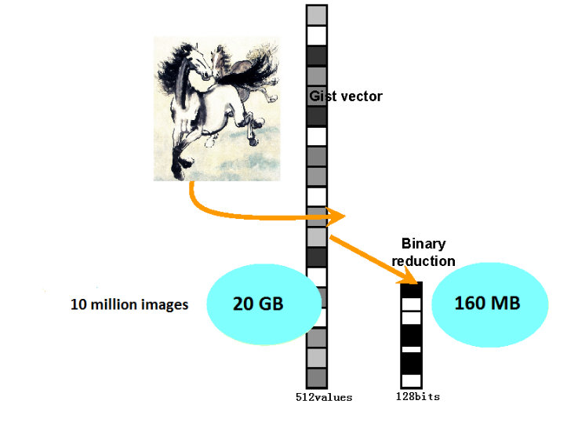
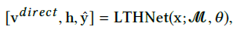
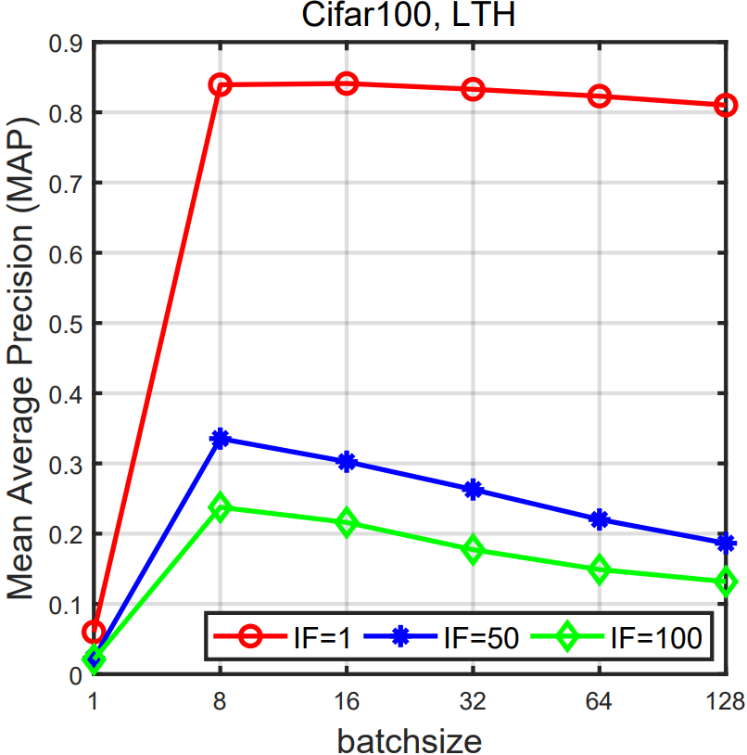
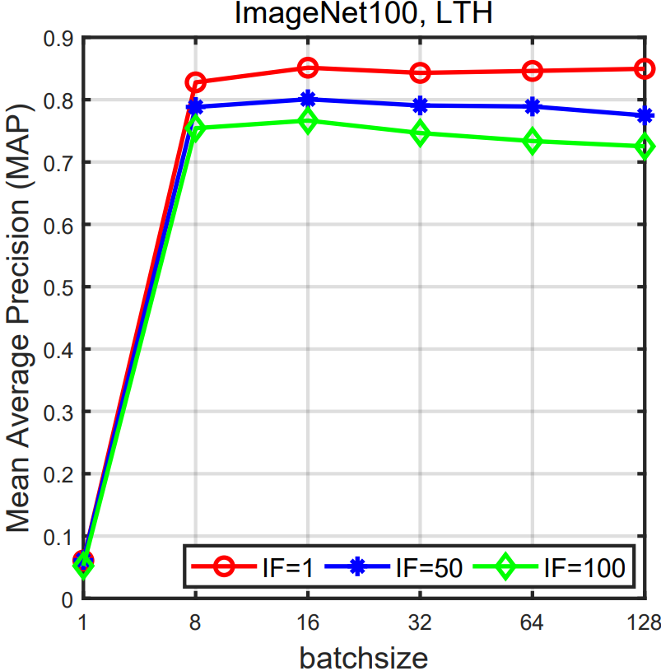
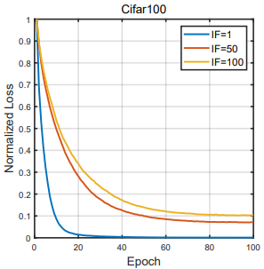
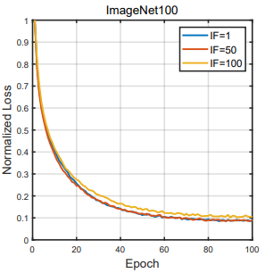
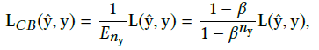
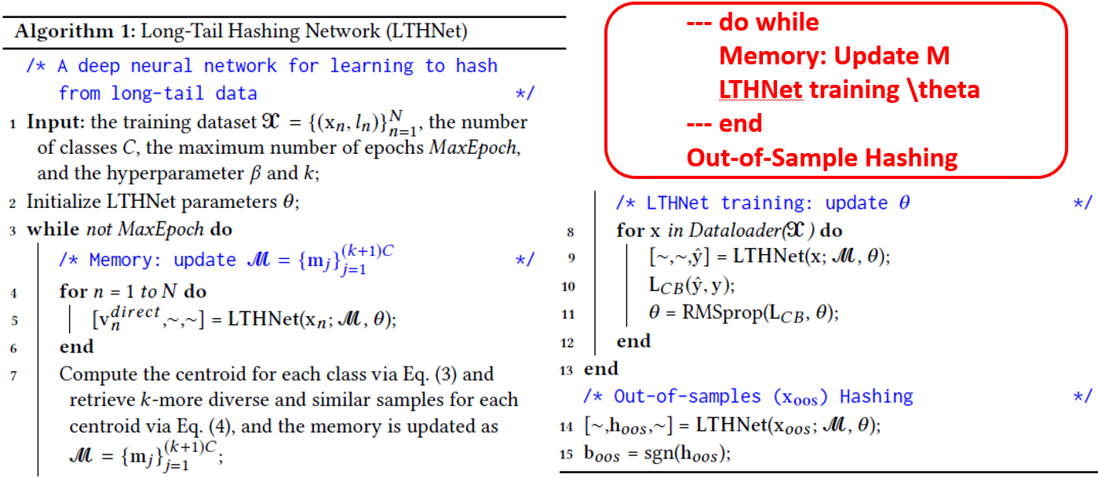


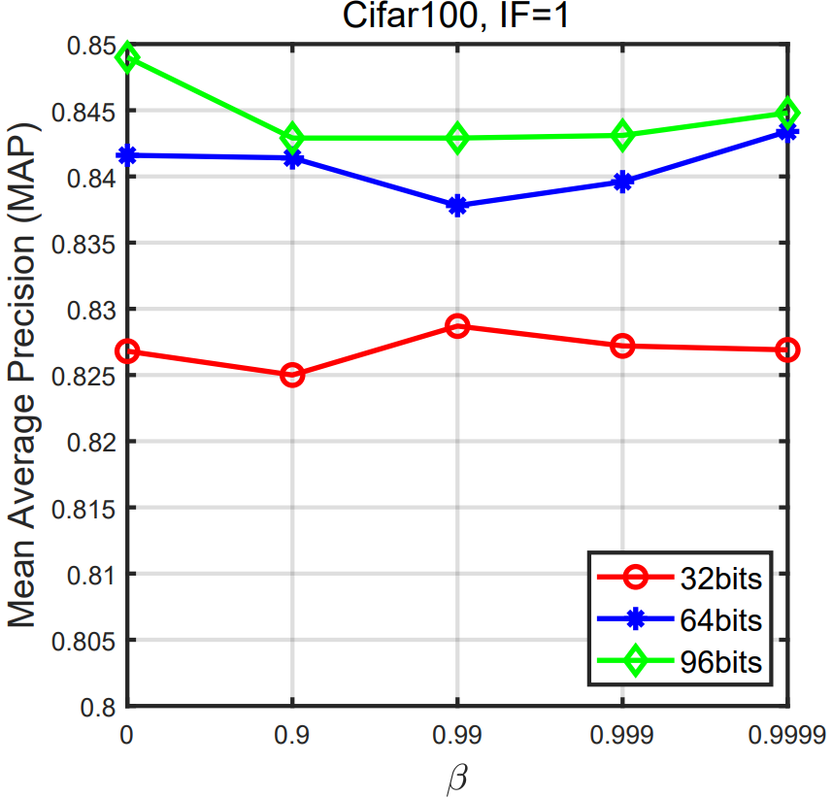
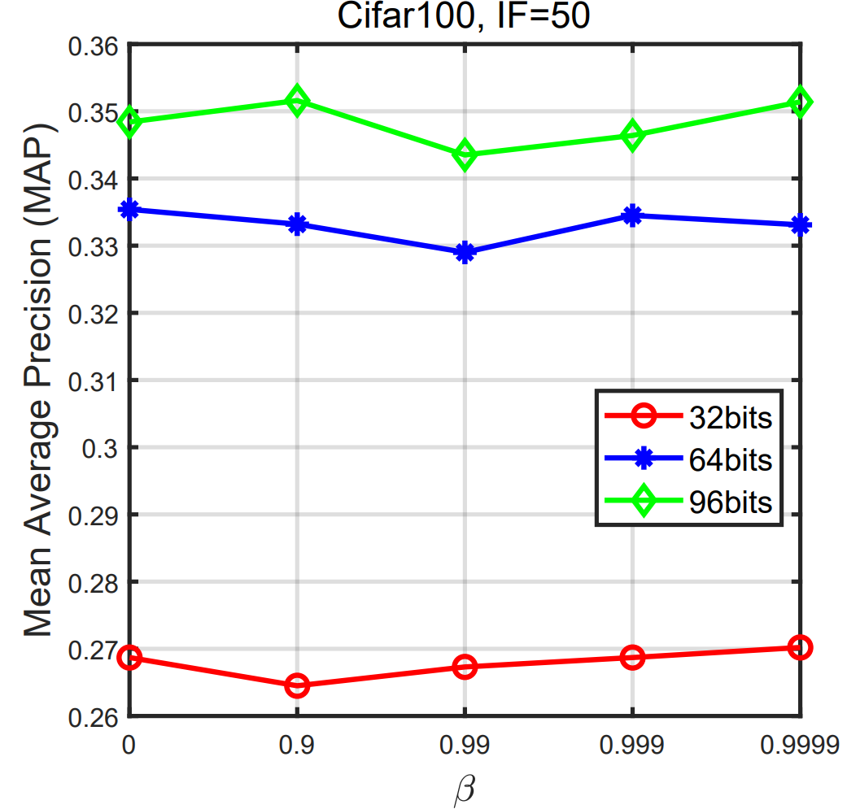
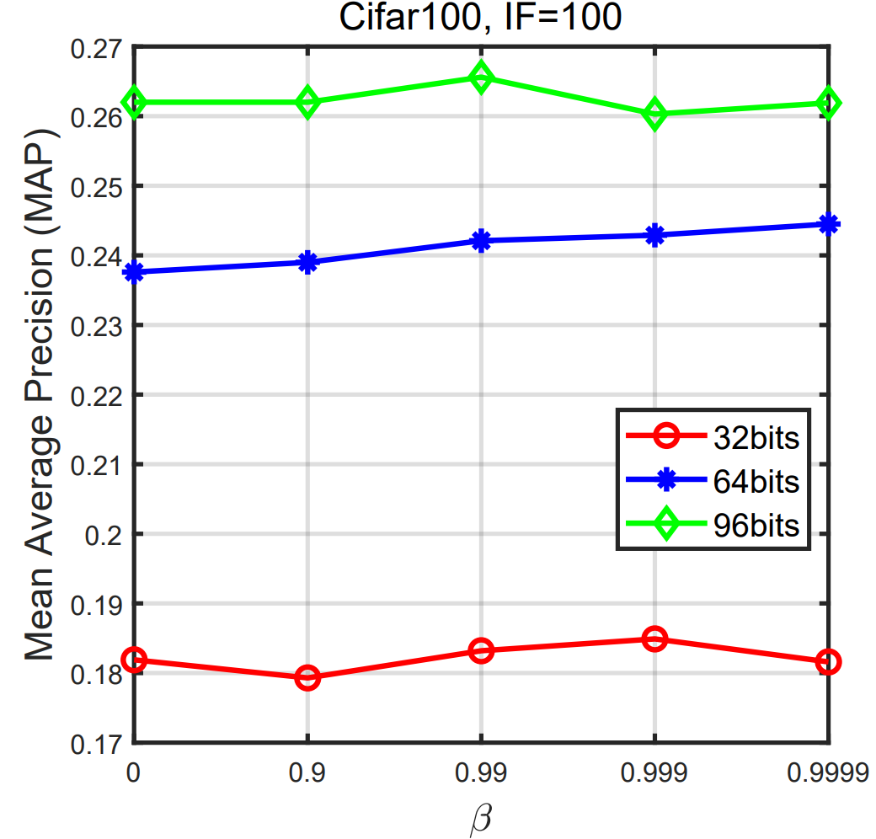
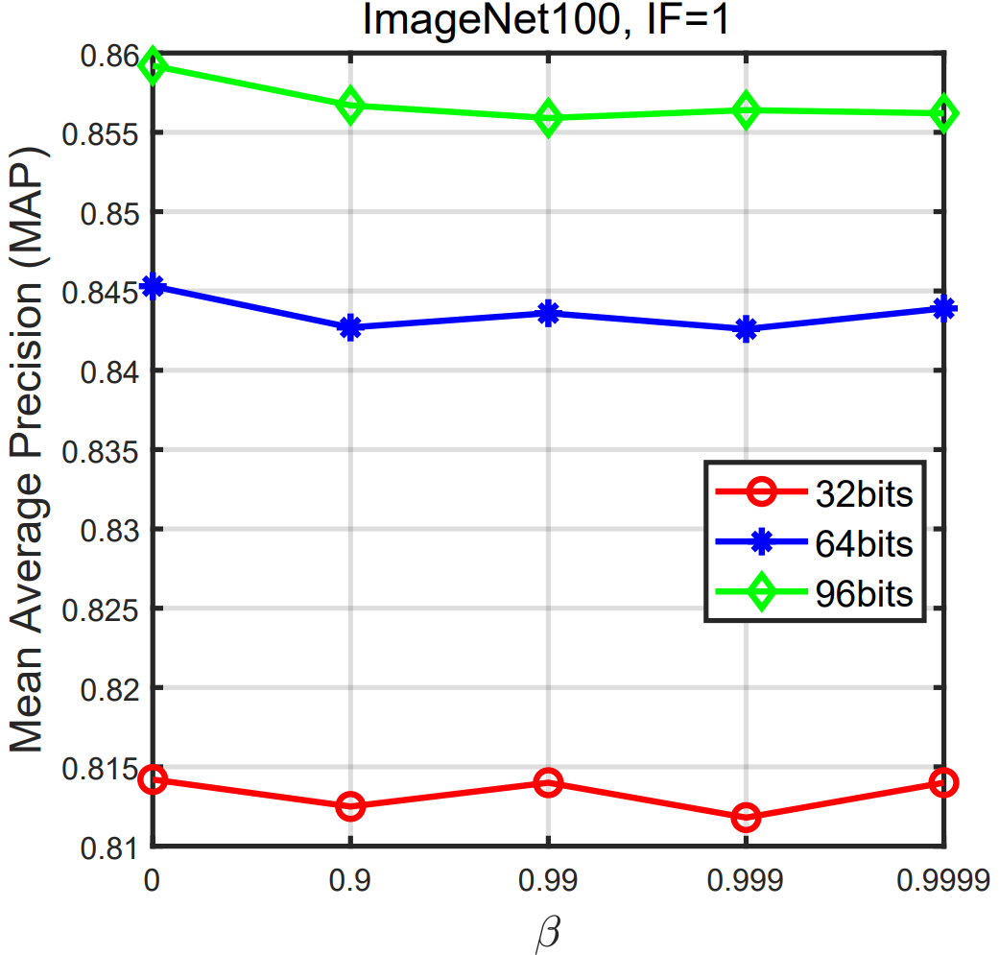
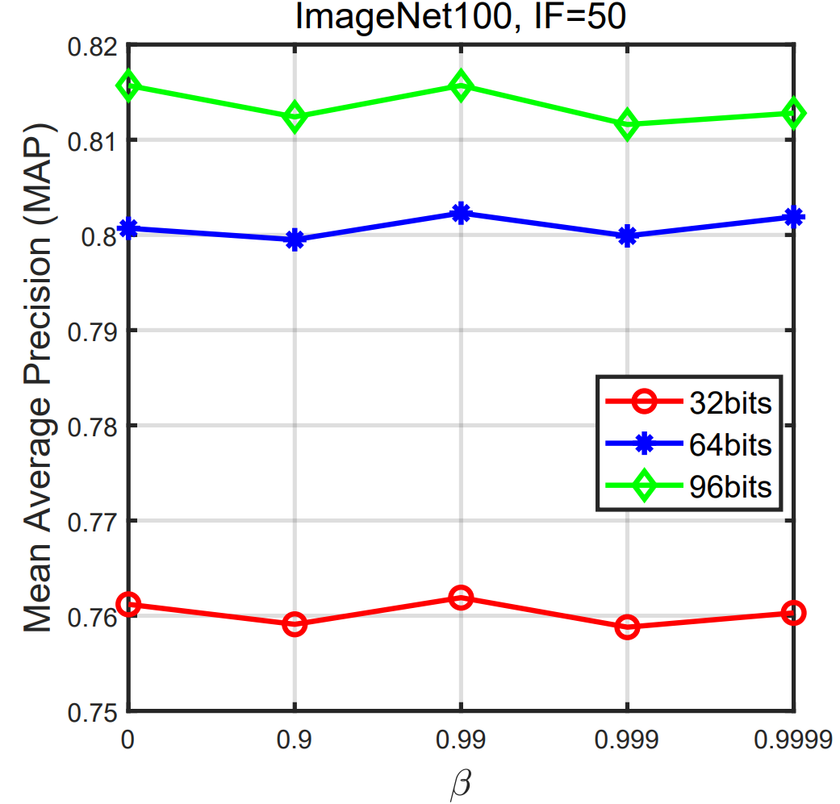
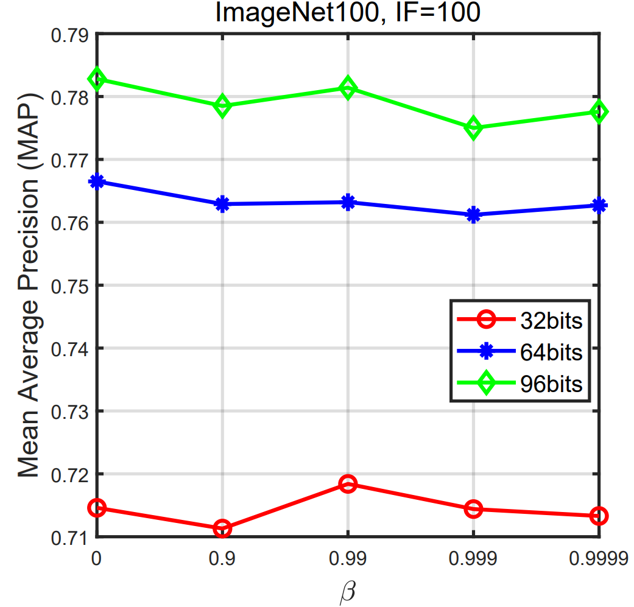

Long-Tail Hashing: Model, Optimization and Application
Yong Chen^{1,2}, Yuqing Hou³, Shu Leng⁴, Qing Zhang³, Zhouchen Lin^{1,2,*} , Dell Zhang^{5,6}
¹Key Lab. Of Machine Perception (MoE), School of EECS, Peking University, Beijing, China
²Pazhou Lab, Guangzhou, China ³Meituan, Beijing, China
⁴Department of Automation, Tsinghua University, Beijing, China
⁵Blue Prism AI Labs, London, UK ⁶Birkbeck, University of London, UK
Abstract
Motivations & Challenges
Experiments & Results
Take-Away Messages
Hashing, which represents data items as compact binary codes, has been becoming a more and more popular technique, e.g., for large-scale image retrieval, owing to its super fast search speed as well as its extremely economical memory consumption. However, existing hashing methods all try to learn binary codes from artificially balanced datasets which are not commonly available in real-world scenarios. In this paper, we propose Long-Tail Hashing Network (LTHNet), a novel two-stage deep hashing approach that addresses the problem of learning to hash for more realistic datasets where the data labels roughly exhibit a long-tail distribution. Specifically, the first stage is to learn relaxed embeddings of the given dataset with its long-tail characteristic taken into account via an end-to-end deep neural network; the second stage is to binarize those obtained embeddings. A critical part of LTHNet is its dynamic meta-embedding module extended with a determinantal point process which can adaptively realize visual knowledge transfer between head and tail classes, and thus enrich image representations for hashing. Our experiments have shown that LTHNet achieves dramatic performance improvements over all state-of-the-art competitors on long-tail datasets, with no or little sacrifice on balanced datasets. Further analyses reveal that while to our surprise directly manipulating class weights in the loss function has little effect, the extended dynamic meta-embedding module, the usage of cross-entropy loss instead of square loss, and the relatively small batch-size for training all contribute to LTHNet's success.
1. The Visual World is Long-Tail Distributed.
1. Long-Tail Datasets.
(1) Deep Learning + Memory Mechanism;
2. There appears Diverse Technologies and Theories.
2. Results on Cifar100 & ImageNet100.
(2) Comprehensive Tricks: Model + Loss + Training;
Deep Learning:
Representation and Generalization
Attention is All your need:
Memory Mechanism
Transfer Learning:
Across head/tail Classes, Domains
Cifar100
(3) What if a retrieval system consistently encounters Accumulated data including New Classes' data ?
3. Challenges.
Is there any Unified paradigm to Achieve good representations?
Preliminary Explorations
Incremental Learning
Lifelong Machine Learning
1. Long-Tail Hashing.
ImageNet100
References (Excerpts)
Introduction
1. Learning to Hash.
1. Nearest Neighbor Search (NNS) is underlying many Machine Learning, Data Mining, Information Retrieval problems.
2. Solution: Long-Tail Hashing Network.
Li Yuan, Tao Wang, Xiaopeng Zhang, Francis E. H. Tay, Zequn Jie, Wei Liu,
Jiashi Feng: Central Similarity Quantization for Efficient Image and Video Retrieval.
CVPR 2020: 3080-3089.
(2) Qi Li, Zhenan Sun, Ran He, Tieniu Tan: A General Framework for Deep
Supervised Discrete Hashing. Int. J. Comput. Vis. 128(8): 2204-2222 (2020).
K-NN Classifier & IR
K-Means Clustering
Anomaly Detection
(3) Yong Chen, Zhibao Tian, Hui Zhang, Jun Wang, Dell Zhang: Strongly Constrain
-ed Discrete Hashing. IEEE Trans. Image Process. 29: 3596-3611 (2020).
2. When NNS meets Big Data?
(1) Curse of dimensionality;
(2) Storage cost;
(3) Query speed;
3. Mathematics: Dynamic Meta-Embedding & Classifier & Loss Function.
3. Dynamic Meta-Embedding: TRUE or FALSE?
2. Long-Tailed Visual Recognition.
Dymamic Memory:
(4) Ziwei Liu, Zhongqi Miao, Xiaohang Zhan, Jiayun Wang, Boqing Gong, Stella X.
Yu: Large-Scale Long-Tailed Recognition in an Open World. CVPR 2019: 2537-2546.
As the dimensionality increases, a larger percentage of the training data resides in the corners of the feature space.
Meta-Embedding:
(5) Boyan Zhou, Quan Cui, Xiu-Shen Wei, Zhao-Min Chen: BBN: Bilateral-Branch
Network With Cumulative Learning for Long-Tailed Visual Recognition. CVPR
2020: 9716-9725.
3. Learning to Hash: A Memory-Economical and Computation-Fast Representation Learning.
LTHNet: Inputs & Outputs:
4. How Batch-size affects the MAP results? & Convergence Curves.
(6) Linchao Zhu, Yi Yang: Inflated Episodic Memory With Region Self-Attention for Long-Tailed Visual Recognition. CVPR 2020: 4343-4352.
Generalized Class-balanced Loss:
4. Learning Algorithm.
Acknowledgements
(2) Reduce Dimensionality and
Storage Cost
5. How $β$ (class re-weight) affects the MAP results?
We thank the anonymous reviewers for their helpful comments. Zhouchen Lin is supported by the Key-Area Research and Development Program of Guangdong Province (Grant No. 2019B121204008), National Natural Science Foundation of China (Grant No. 61625301 & 61731018), Major Scientific Research Project of Zhejiang Lab (Grant No. 2019KB0AC01 & 2019KB0AB02), Beijing Academy of Artificial Intelligence, and Qualcomm. .
(1) Similarity Preserved Hashing
(3) By using hash-code to construct index, we can achieve constant or sub-linear search time complexity.

